Slide 1
Tree Based Methods in Machine Learning
Akshay Sehgal
20th March 1990

Slide 2
Naïve Bayes

Slide 3
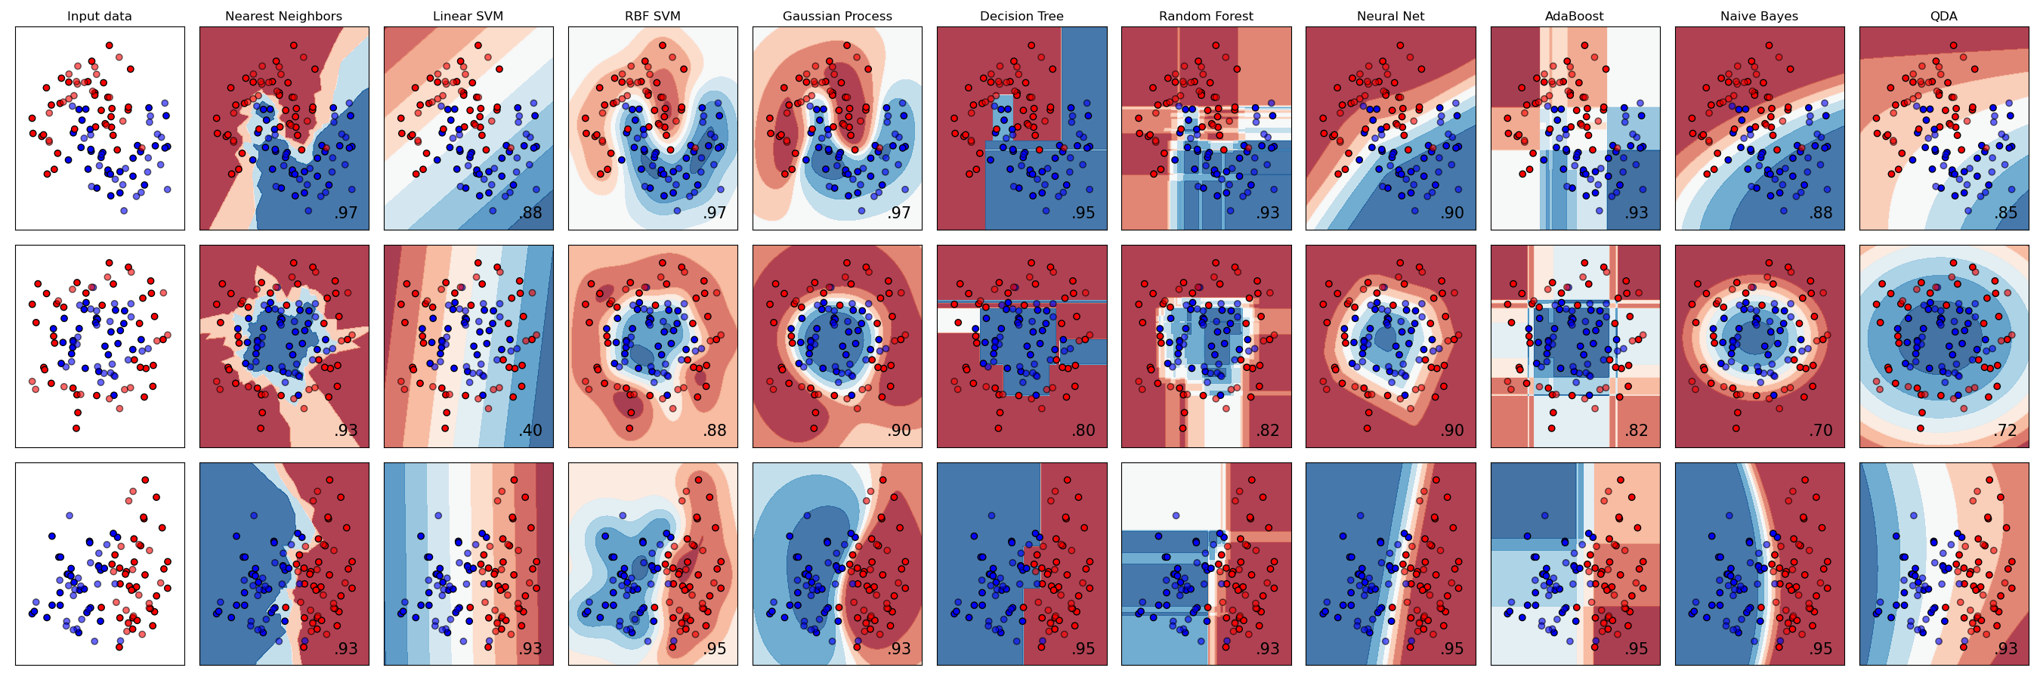
Comparison of Decision Boundaries for different classifiers

Slide 4
Decision Trees

Slide 5
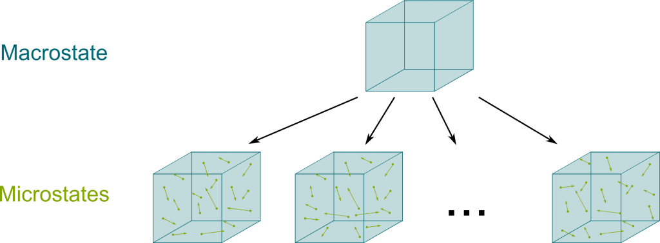


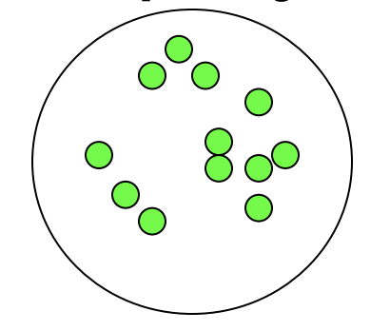
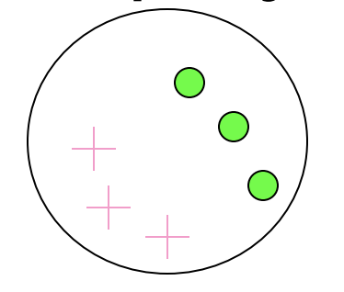
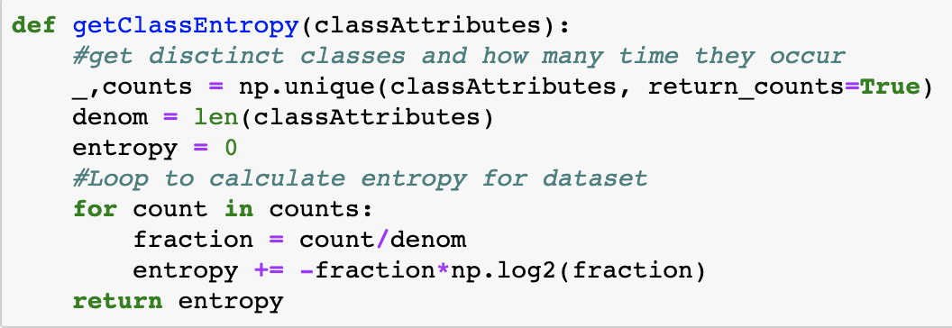
Concept of Entropy
Entropy deals with the number of microstates that are consistent with a given macrostate. Entropy talks about how many such states can a system exist in.
Say we have two containers of gas, and we know the macroscopic properties of both. There are N1 possible "microstates" for the first container, and N2 for the second.
As more systems are added together, the macro properties can simply be added (volume, mass, energy etc.) but the microstates needs to be multiplied. So, a weighted sum of the log of microstates lets us work with them more easily.
The higher the number of possible microstates in a given set, the larger is its degree of disorder or Impurity.
Minimum Impurity
Maximum Impurity
S = - 1 log₂1 = 0
S = - 0.5 log₂0.5 - 0.5 log₂0.5 =1

Slide 6
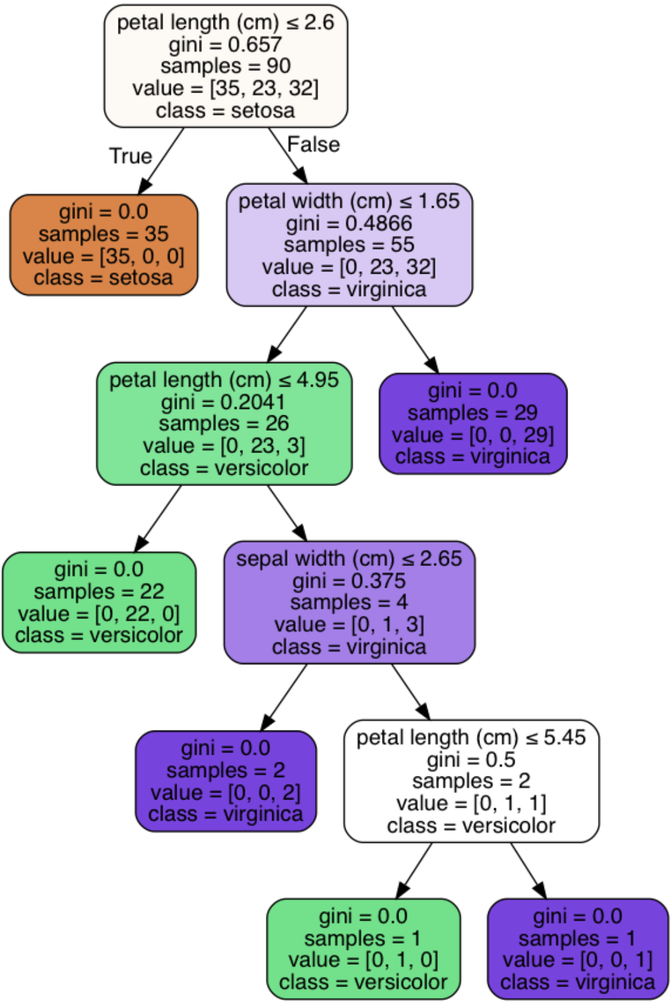

Decision Trees
Decision trees are an algorithm that keeps splitting the data based on "Questions" such that asking a certain number of questions on the data results in near perfect prediction of which class it belongs to. The questions are of the form Sex==Male?, Weight>=55?, Petal Length<=2.45, etc. The objective of a decision tree is to find the right set of questions to ask.
There are various types of decision tree models, most popular of which is CART (classification and regression trees, others being ID3, C4.5, C5.0). In CART, you have the following steps -
Start with a root node with complete data
Make a list of questions based on the distinct values in the dataset
Split the data into child nodes based on the question and calculate the "Impurity" of each node
Calculate how good the question was by calculating the "Information Gain" from the split
Repeat recursively till the you cant find better splits
Types of Impurity measures to check purity of the nodes.
𝐸𝑛𝑡𝑟𝑜𝑝𝑦 = − ∑ 𝑝_{𝑗} ∗ 𝑙𝑜𝑔₂𝑝_{𝑗}
𝐺𝑖𝑛𝑖 = 1 − ∑𝑝²_{𝑗}
𝐶𝐸 = 1 − 𝑚𝑎𝑥(𝑝_{𝑗})
Information Gain is a measure of how much information is gained / how much the overall impurity has decreased after a certain action (such as splitting a set into n parts)

Slide 7
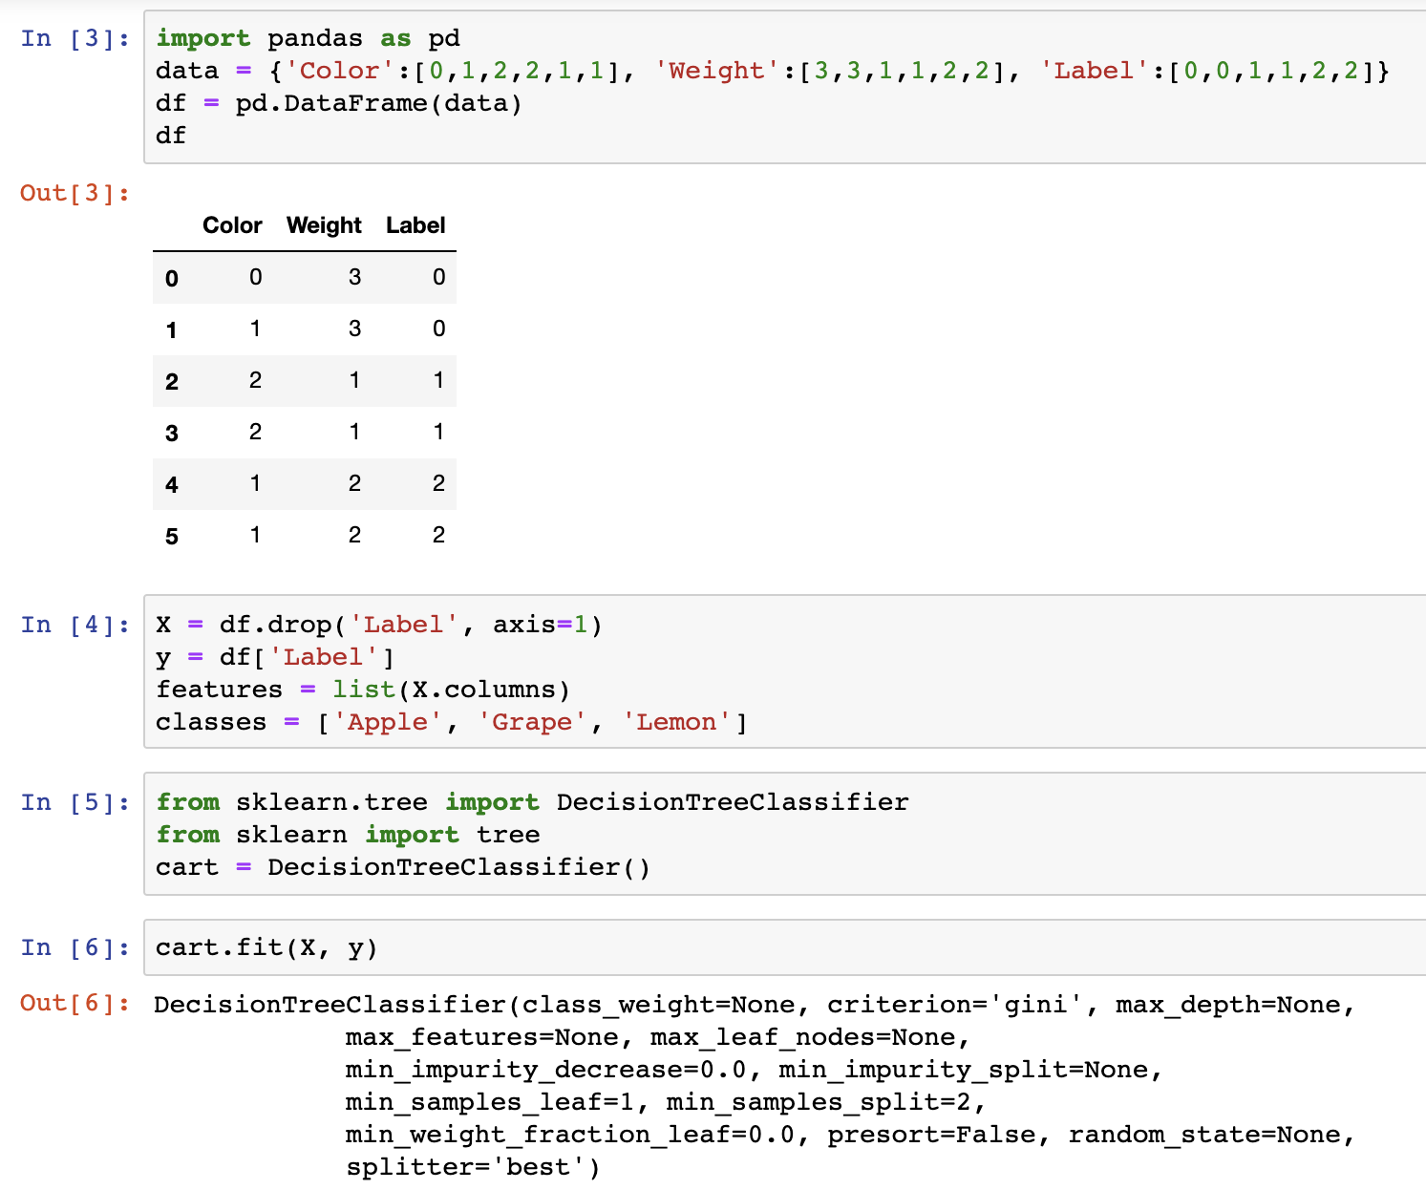
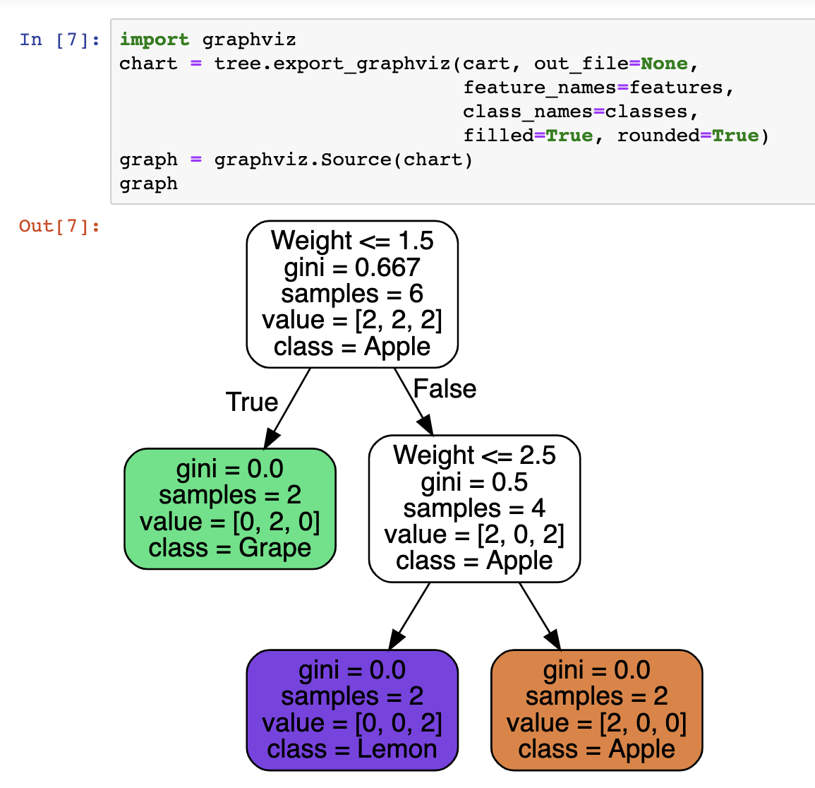
Implementing Decision Trees

Slide 8
Comparison of Decision Boundaries for different classifiers

Slide 9
Random Forest

Slide 10
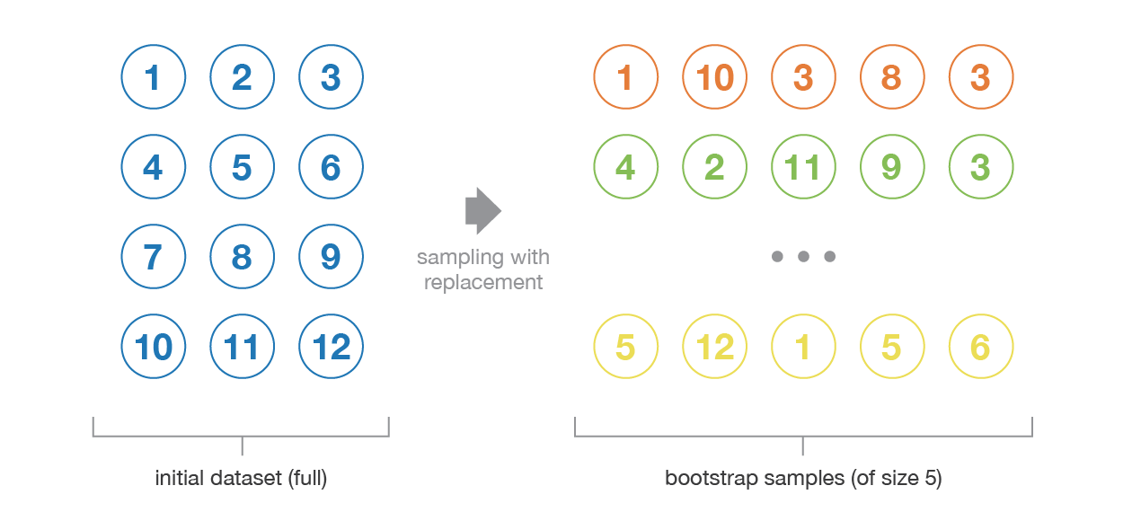
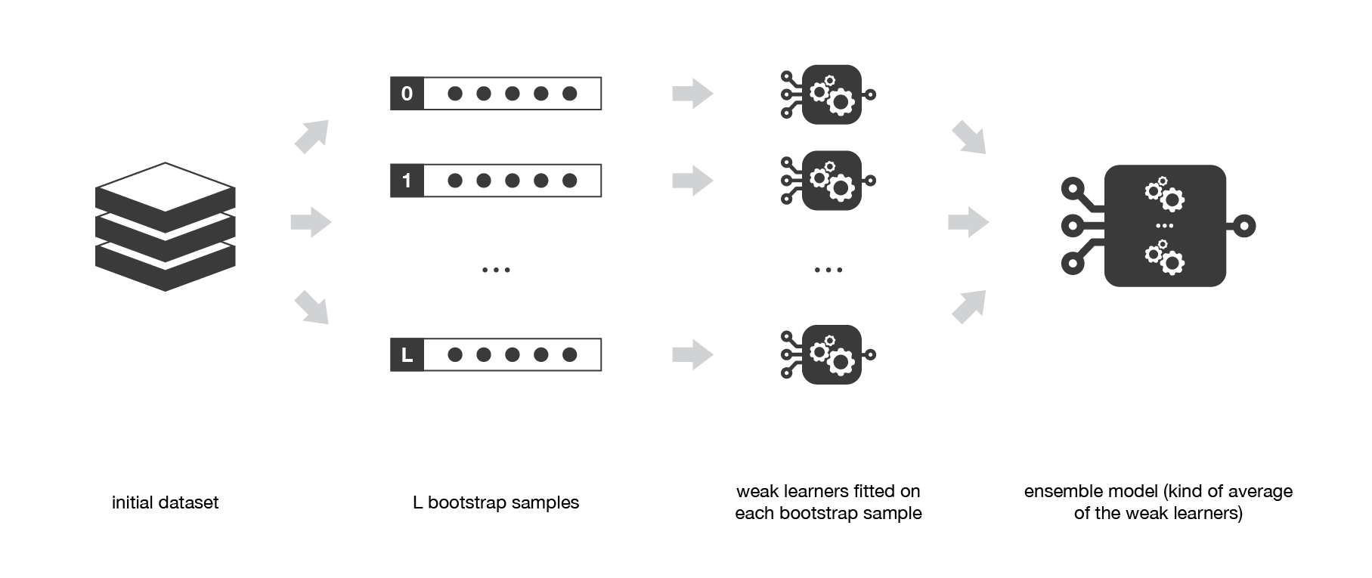
Bagging
Ensemble learning is a machine learning paradigm where multiple models (often called “weak learners”) are trained to solve the same problem and combined to get better results. The main hypothesis is that when weak models are correctly combined, we can obtain more accurate and/or robust models.
Bagging (Bootstrap Aggregation)
Considers homogeneous (“of the same type”) weak learners, learns them independently from each other in parallel and combines them following some kind of deterministic, averaging process.
Bootstrapping
Let's say that each classifier is trained on about 63% data. The remaining 37% data is called out-of-bag samples (OOB). So for each sample 𝑋_{𝑖} we can evaluate the set of models for which 𝑋_{𝑖} was a OOB sample. Then for only this set of models, vote/average their predictions, compare to actual and calculate the OOB error estimate of the model. This approach is quite similar to cross-validation.
Why does aggregation work?
Imagine n features represented as 𝑍,𝑍₁,𝑍₂,...,𝑍_{𝑛} each with a mean of 𝜇 and variance of 𝜎². When you take the average of the features, what you end up with is 𝑍_{𝑀} which still has a mean of 𝜇 BUT its variance now becomes 𝜎²/𝑛, thus shrinking the variance while keeping the same mean. This same analogy is used in prediction functions.
So if we have N independent training sets, fit N classifiers, then take average of the predictions, our ensemble model still has the expected mean prediction, but the variance of predictions reduces, making the final model much stronger than the individual weak learners.
Since we don't have independent training sets, we bootstrap the same training data with replacement, which doesn't give us the full reduction in variance.

Slide 11
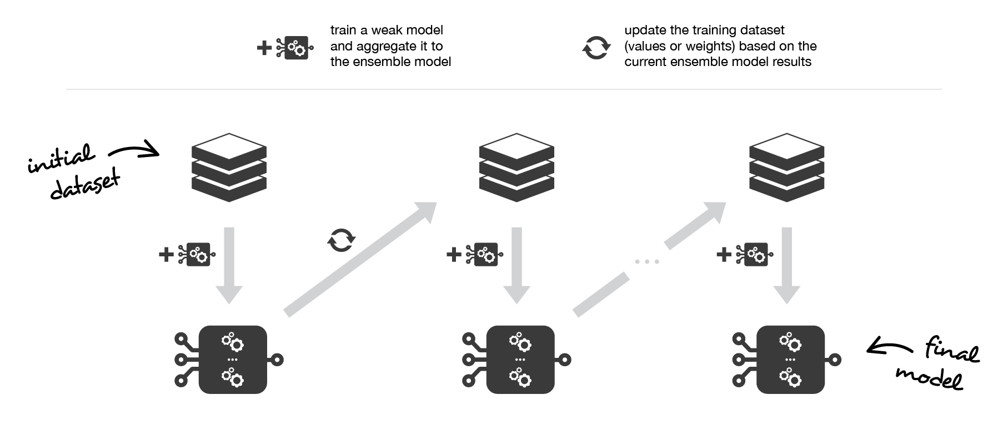
Boosting
Considers homogeneous weak learners, learns them sequentially in a very adaptative way (a base model depends on the previous ones) and combines them following a deterministic strategy. Example (GBM)

Slide 12
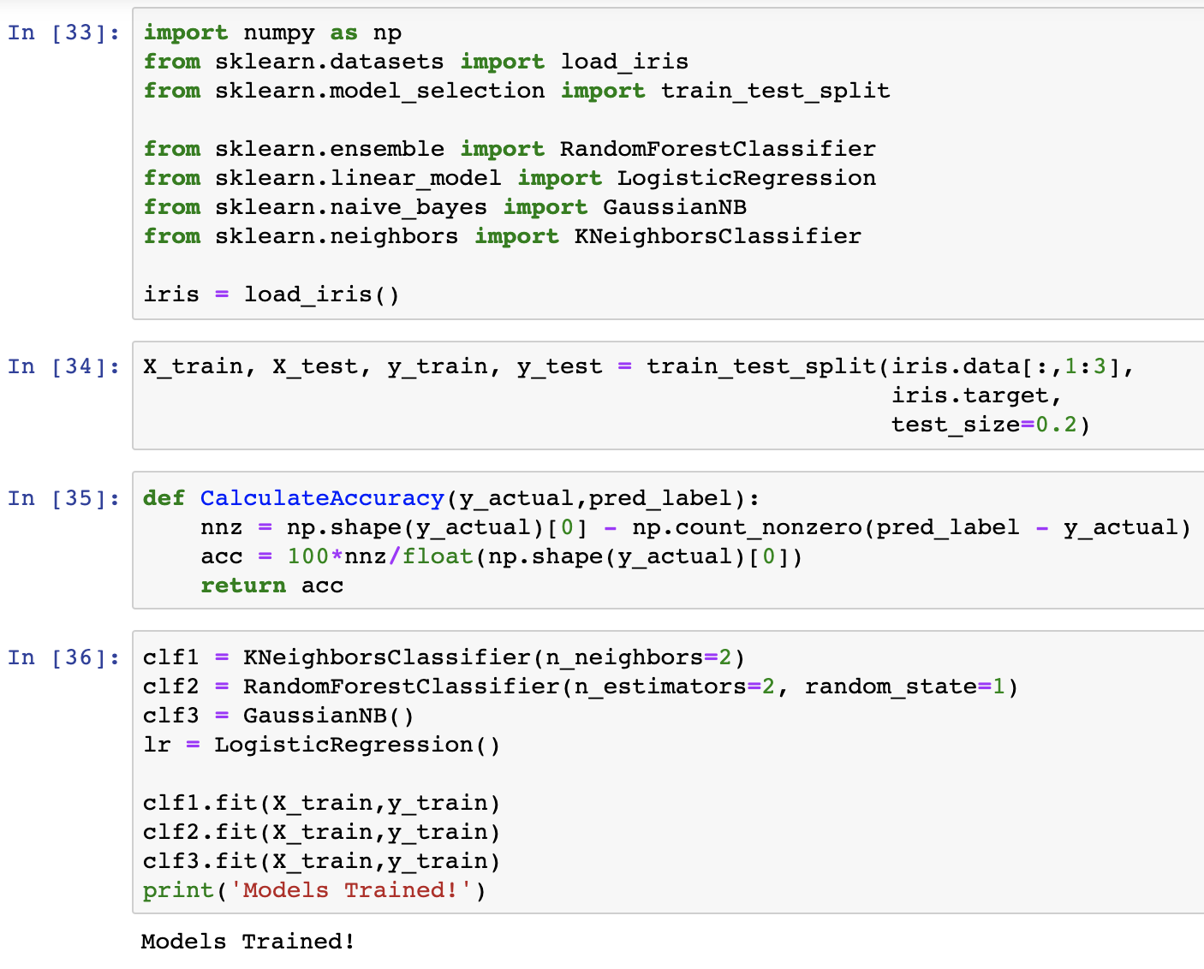
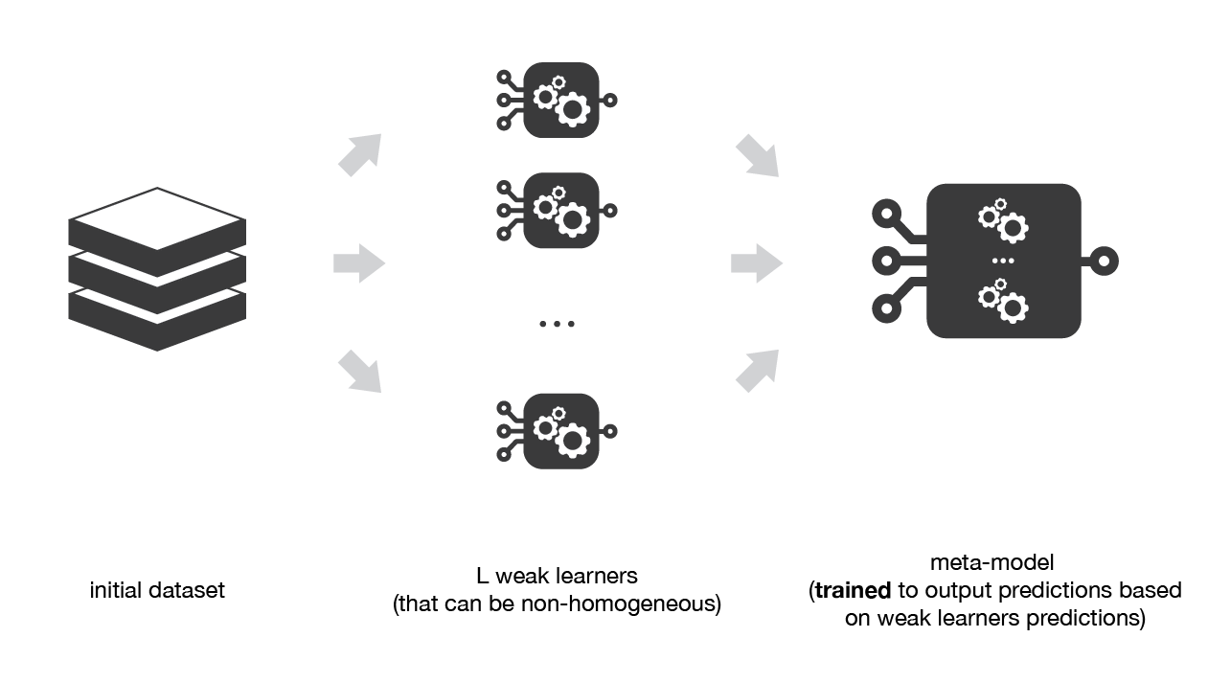
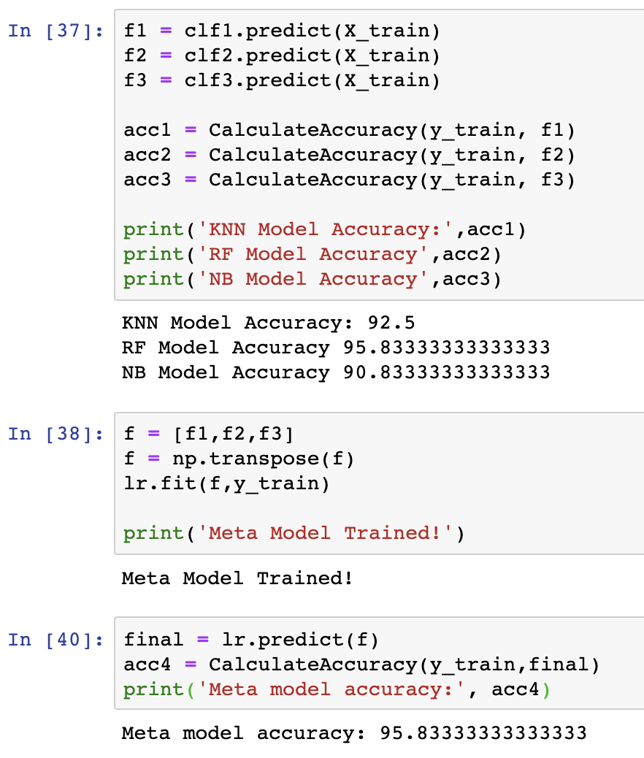
Stacking
Considers heterogeneous weak learners, learns them in parallel and combines them by training a meta-model to output a prediction based on the different weak model predictions. Example (Stacknet).

Slide 13
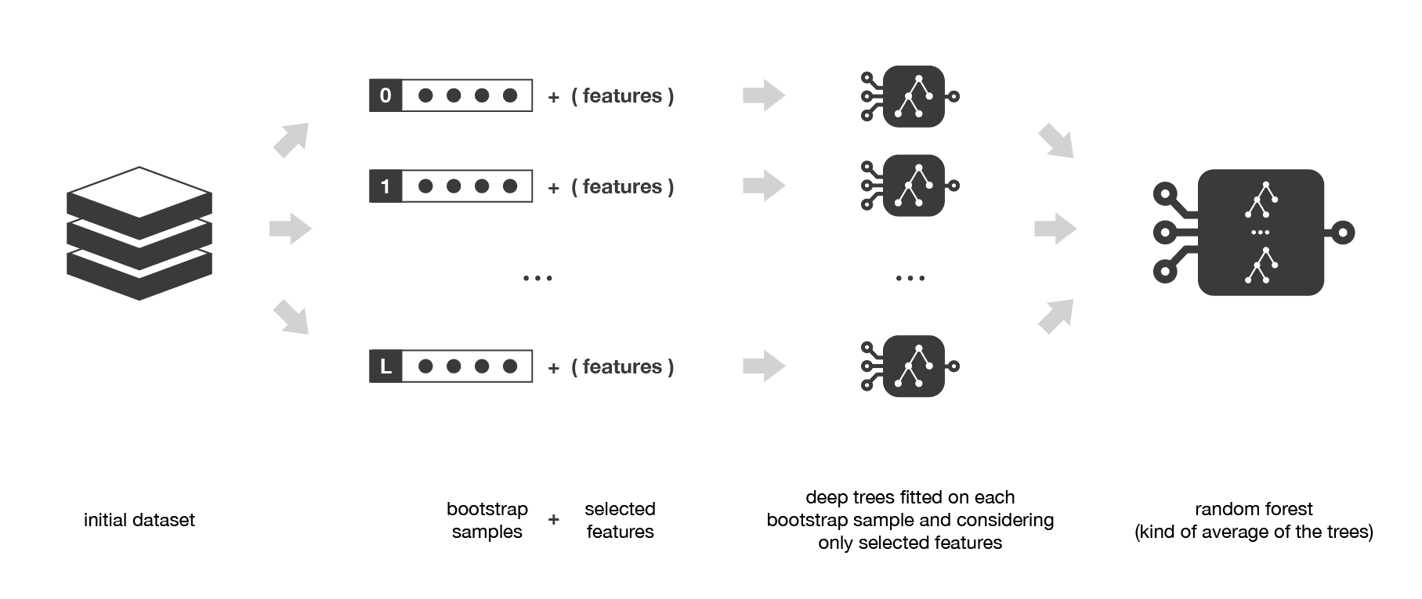
Random Forest
Learning trees are very popular base models for ensemble methods. Strong learners composed of multiple trees can be called “forests”. Trees that compose a forest can be chosen to be either shallow (few depths) or deep (lot of depths, if not fully grown). Shallow trees have less variance but higher bias and then will be better choice for sequential methods. Deep trees, on the other side, have low bias but high variance and, so, are relevant choices for bagging method that is mainly focused at reducing variance.
The random forest approach is a bagging method where deep trees, fitted on bootstrap samples, are combined to produce an output with lower variance. However, random forests also use another trick to make the multiple fitted trees a bit less correlated with each others: when growing each tree, instead of only sampling over the observations in the dataset to generate a bootstrap sample, we also sample over features and keep only a random subset of them to build the tree.

